Slide 1
4M12: Partial Differential Equations
Peter Davidson
Lecture 2 (of 7)
The Diffusion Equation
Key Points: the ideas of diffusion length and self-similar solutions
Topics for this lecture:
When do we get a self-similar solution?
Examples of self-similar solutions in 1D
3. 1D solution for a point source in an infinite domain (a stepping-stone)
4. Constructing 1D solutions for arbitrary initial conditions (infinite domain)
Spherically symmetric problems
Geophysical examples

Slide 2
1. When Do We Get a Self-similar Solution?
Back to lecture 1
Self-similar solution
Not self-similar
Only get self-similar solution when no imposed geometric length-scale

Slide 3
2. Examples of Self-Similar Solutions in 1D
2.1 Plate in a Viscous Fluid
Expect self-similar solution as no imposed geometric length-scale
Find A and B from boundary conditions

Slide 4
2.1 Plate in a Viscous Fluid Cont…
u(y,t) = V f(y/l(t)) = V f(η)

Slide 5
2.2 Equivalent Thermal Problem
Expect self-similar solution as no imposed geometric length-scale

Slide 6
3. 1D Solution for a Point Source in Infinite Domain
Interpretation?
Try for yourself
Notes:
for heat Q released
at x = x’ at t = 0
(thermal energy is conserved)

Slide 7
4. 1D Solutions for Arbitrary Initial Conditions
A trick: think of T0(x) as composed of lots of
δ-functions, i.e. replace T0(x) in range dx’ by a
δ-function at location x’ of strength T0(x’) dx’.
Can do similar thing for wave and Poisson equations – see later

Slide 8
5. Spherically Symmetric Problems
Example
To + ΔT
Self-similar in Γ
Not self-similar in T
Not self-similar in T

Slide 9
6. Geophysical Examples

Slide 10
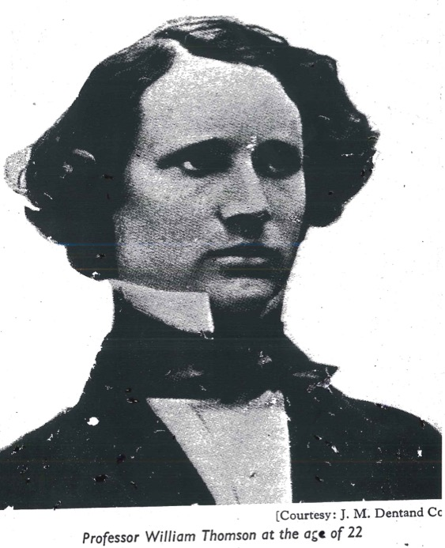
6. Geophysical Examples Cont…
Kelvin as he is usually remembered
Kelvin Aged 22

